Slide 1
Presented by:
Trust and the Virtual Team
Why it's important,
how to build it, and
how to keep it

Slide 2
Welcome!
TODAY'S DISCUSSION
Length: 1 hour
Will this be recorded and
sent out? Yes!
User functionality: Polls, Chat, Q&A
Agenda

Slide 3
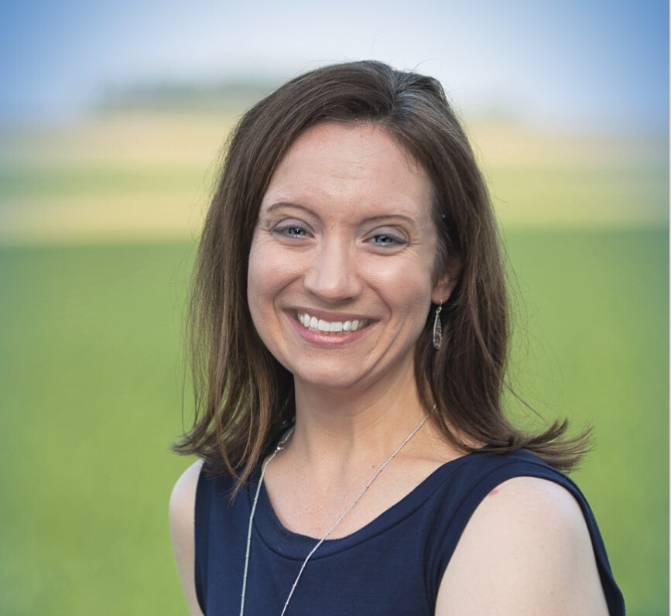
Lisa Strei, MBA
Workplace Coach

Slide 4
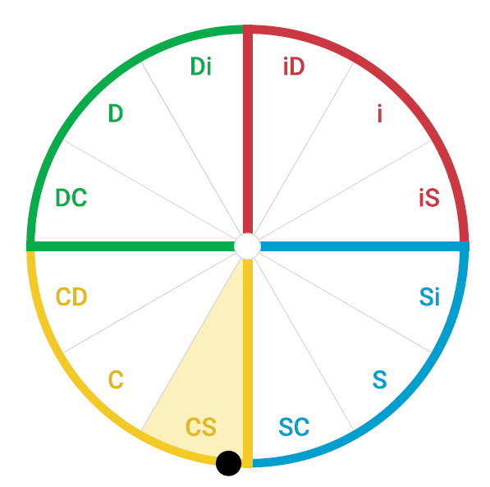
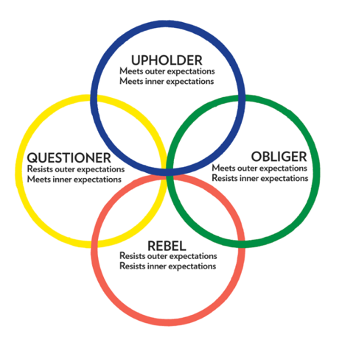

Slide 6
Statistics!

Slide 7
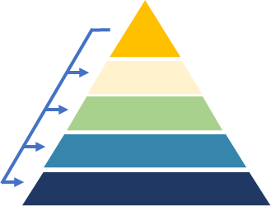

Slide 8
31% Worked mostly or solely in a team structure
65% still had a hierarchical structure, but do some cross-functional teamwork
=96% of the workforce!
**2019 Deloitte Global Human Capital Trends

Slide 9
More Complex
More Fluid
More Remote
60%
**2020 John Wiley & Sons, Inc. State of Teams Report

Slide 10
More Complex
76%
73%
of people work on 2+ teams
of people work on more than 1 type of team
Departmental
Project
Cross-Functional
Management
Matrix
**2020 John Wiley & Sons, Inc. State of Teams Report
0
25
50
75
100

Slide 11
More Fluid
Departmental
Project
Cross-Functional
Management
Matrix
0
25
50
75
100
**2020 John Wiley & Sons, Inc. State of Teams Report

Slide 12
More Remote
**2020 John Wiley & Sons, Inc. State of Teams Report

Slide 13
Teamwork = Better Performance
53%
**2019 Deloitte Global Human Capital Trends

Slide 14
65%
--Teamwork is important!
**2019 Deloitte Global Human Capital Trends

Slide 15
99%
of workers respond that they are "effective" team members
**based on State of Teams survey of 11,000 workers conducted by John Wiley & Sons, Inc.

Slide 16
2/3
4 of 5
teams rarely offer constructive feedback to one another or question each other about their approach to work
people report that their team members are not willing to acknowledge their weaknesses to others
**based on historical assessment data from The Five Behaviors Team Development

Slide 17
55%
typically leave meetings without everyone committing to agreed-upon decisions
**based on historical assessment data from The Five Behaviors Team Development

Slide 18
THE WAY WE TEAM MATTERS

Slide 19
TRUST

Slide 20
POLL

Slide 21
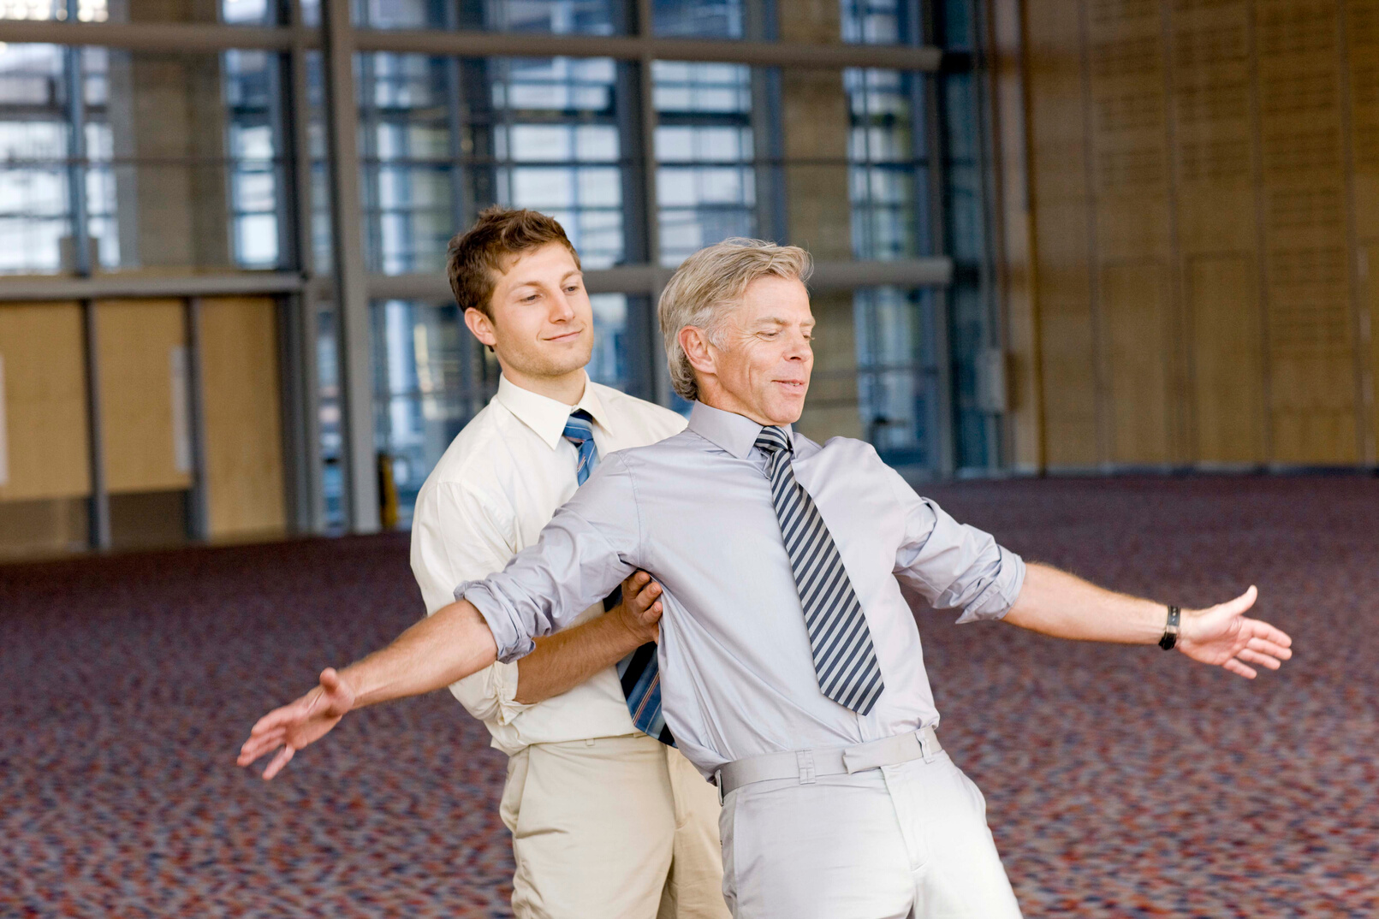
TRUST:
the first and most important behavior

Slide 24
VULNERABILITY-BASED TRUST
Vulnerability is often seen as a sign of weakness; it's actually a sign of strength...
Patrick Lencioni, Founder of The Table Group and Author
of The Five Dysfunctions of a Team

Slide 25
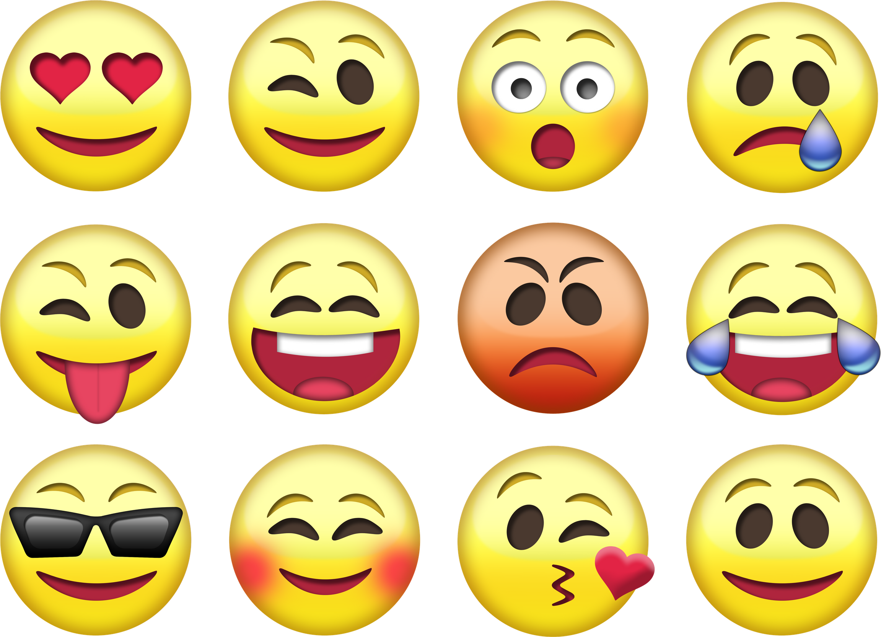

Slide 27
Teams that lack trust...
hesitate to ask for help or offer feedback
don't offer help to people outside of their own areas of responsibility
jump to conclusions
fail to recognize other's skills
waste time and energy managing their own behaviors
hold grudges
avoid their teammates

Slide 29
Being unguarded and genuine
What does it look like
Apologizing & being open about weaknesses and mistakes
Giving one another the benefit of the doubt
TO HAVE TRUST ON A TEAM?
Asking for help and input

Slide 30
Having vulnerability-based trust creates the foundation on which a team can build upon to engage in other key behaviors of a cohesive team

Slide 34
Personal Histories Exercise
Easy
Not-overly sensitive
Increases greater understanding
Decreases inaccurate behavioral attributions
30 minutes!

Slide 35
Team Effectiveness Exercise
More rigorous
More relevant
Single most important contribution
Area of improvement
Low tension
60 minutes

Slide 36
Assessments
Non-Judgmental
Based on extensive research
Strengths and tendencies
Active participation
Discover & affirm
Length: varies

Slide 37
360-Degree Feedback
Only if it's disconnected from compensation
and appraisals

Slide 40
Building Trust Takes Time
SHORT-TERM VS.
LONG-TERM IMPACTS

Slide 44
What if you're not the leader??
Can you still encourage trust on your team?
Here's a hint:

Slide 45
Model vulnerability

Slide 46
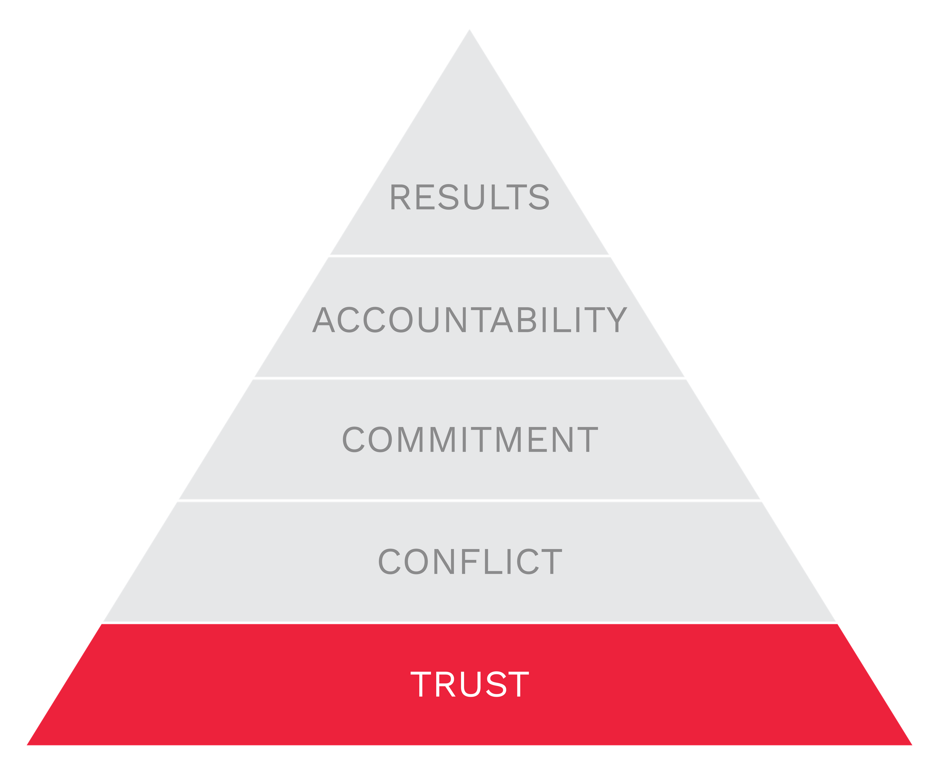
The result?

Slide 47
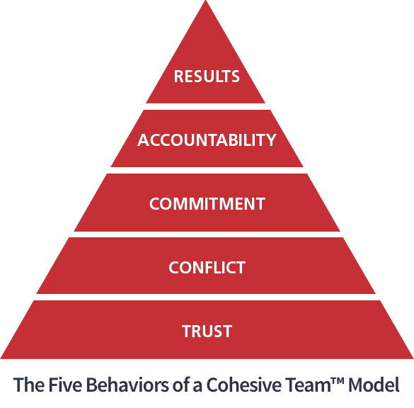

Slide 49
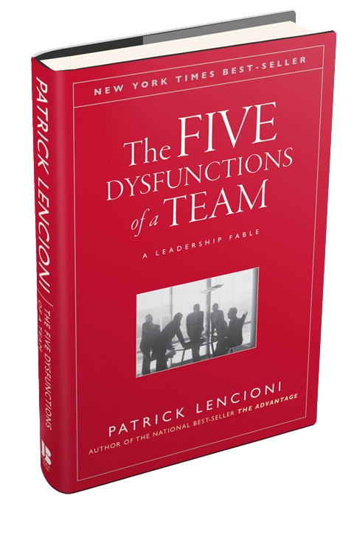

Slide 52
What effective teamwork looks like
$150
Create a common language
Skill development
Create cohesion & boost morale

Slide 53
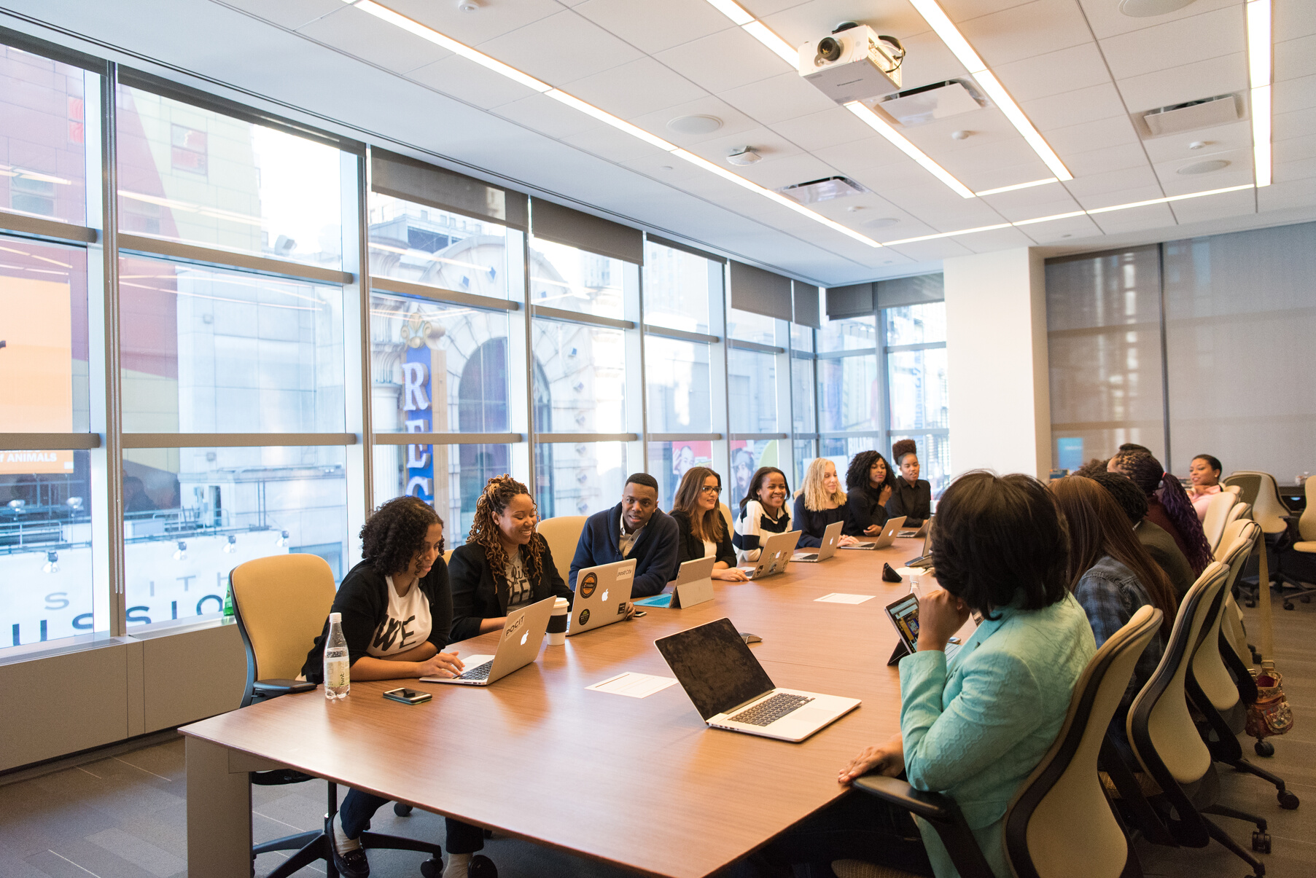
Virtual & Concise
100% Personalized
FREE Analysis & Customization
10% Off Assessments
FREE Additional 30 minutes added to your team's workshop!
Maximize your team's potential!

Slide 54
10% Off Assessment
FREE Coaching Session to review your results!
Maximize your individual potential!

Slide 55
Next Steps
Watch for your follow up email
Save the link to webinar recording
Choose your special offer and click the link to take advantage!
Unlock the potential that awaits!

Slide 56
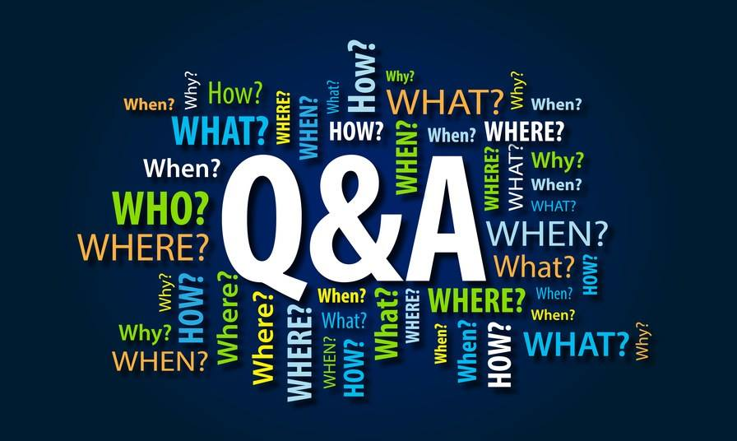
Contact Information
www.LisaStrei.com
@CoachLisaStrei
Email Address
LisaStrei19@gmail.com
Phone Number
801-390-6377

